Slide 1
GROIN PAIN REFERRAL FROM DISTAL SITES
ASHTON VICE
B.Sc. D.C (U.S.A), LRCC (U.K)
CHIROPRACTOR
www.londonsjc.co.uk
NSPINE
2 SAVOY PLACE
LONDON
1-3 JULY 2019

Slide 2
A DIAGNOSTIC DILEMMA :
PAIN IN THE GROIN….. BUT NOT IN THE GROIN?
IF NOT IN THE GROIN? WHERE DOES IT COME FROM?
GROIN PAIN REFERRAL FROM DISTAL SITES

Slide 3
WHAT WE WILL NOT DISCUSS : ENTITIES OF LOCAL GROIN-HIP PAIN
CONGENITAL: LCPD, CAM DEFECTS
INFLAMATORY: ARTHRITIS IN ITS MANY FORMS/ LYMPHOEDEMA/ILIOPSOAS CONTRACTING OVER AN INFLAMED BURSA, APPENDICITUS,ZOSTER
DEGENERATIVE: ARTHRITIS IN ITS MANY FORMS, IMPINGEMENT SYNDROMES OF THE ACET/FEMORAL JOINT
NEOPLASTIC: METS
TRAUMA: LABRAL TEARS/DISLOCATION/ADDUCTOR STRAINS/STRESS FRACTURES/ GILMORE GROIN, INGUINAL HERNIA/AVULSIONS
VASCULAR: OCCLUSIONS OF FEMORAL ARTERY/VEIN, (BRUITS)/DVT, AVN
PSYCOGENIC: SUPRA TENTORIAL DIAGNOSIS

Slide 4
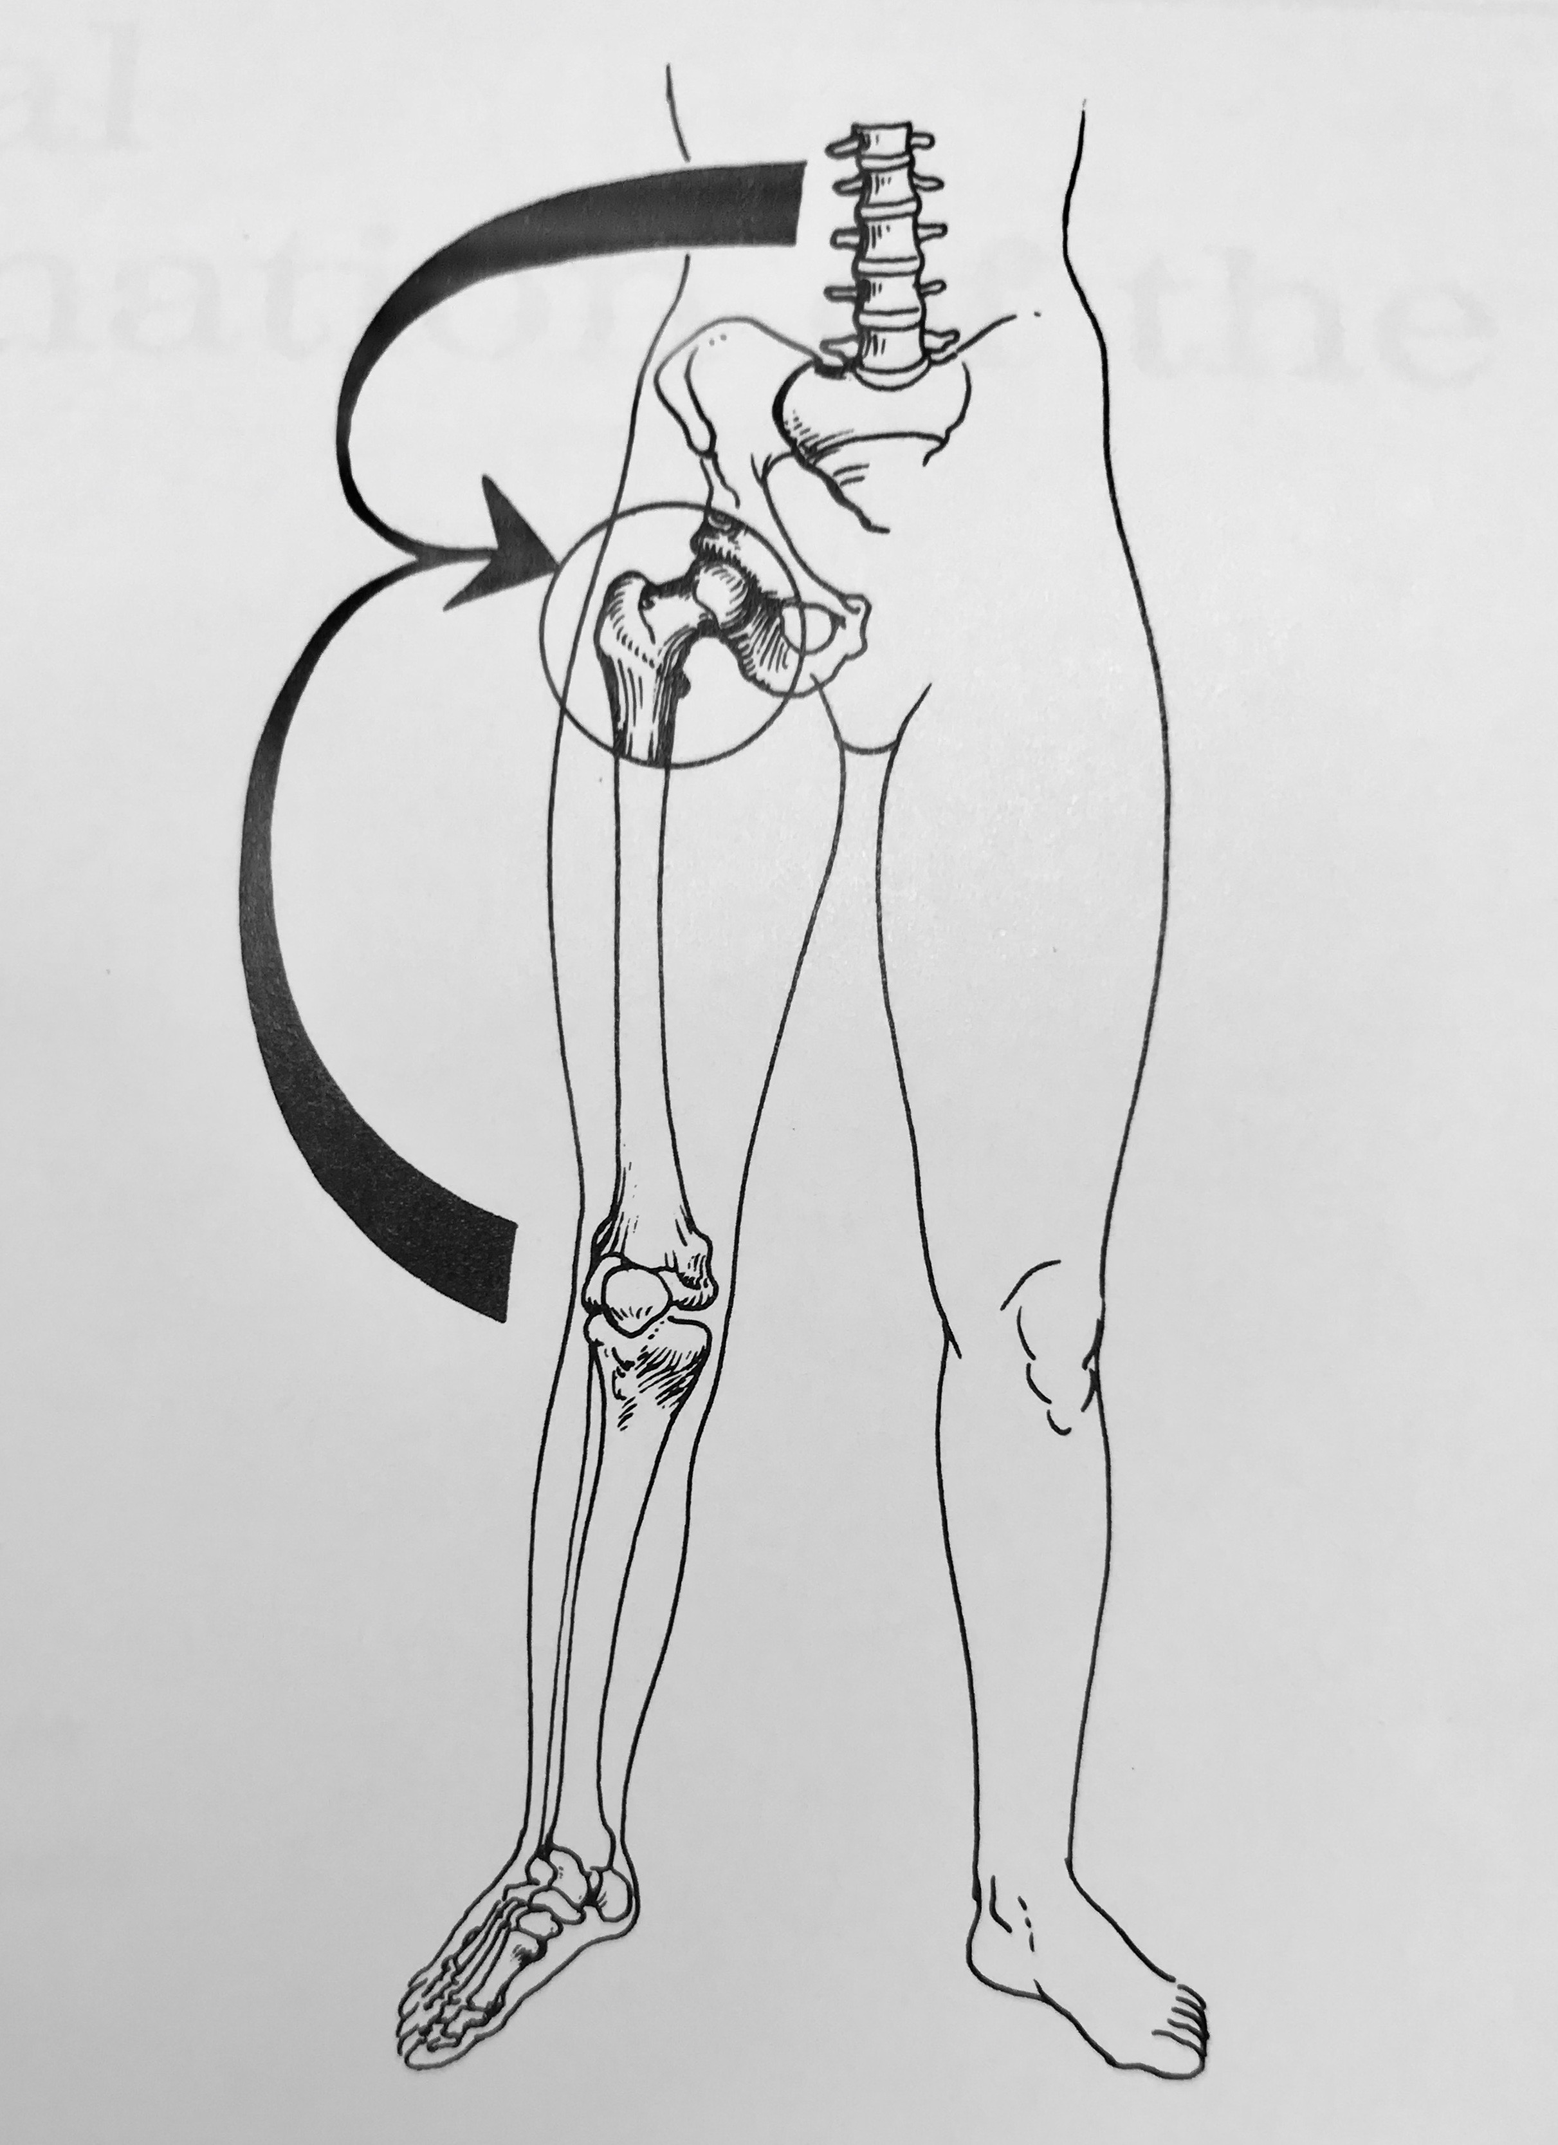
WHAT WE WILL DISCUSS : PAIN REFERRAL FROM DISTAL SITES TO THE GROIN

Slide 5
PAIN REFERRAL FROM DISTAL SITES TO THE GROIN
VISCUS: Urological
SPINE: Neurological entrapment: facet, nerve: subcostal nerve Ilioinguinal, genitofemoral nerve.
Sacroiliac joint.
MYOFASCIAL: Iliopsoas, Adductor Magnus. External Oblique

Slide 6
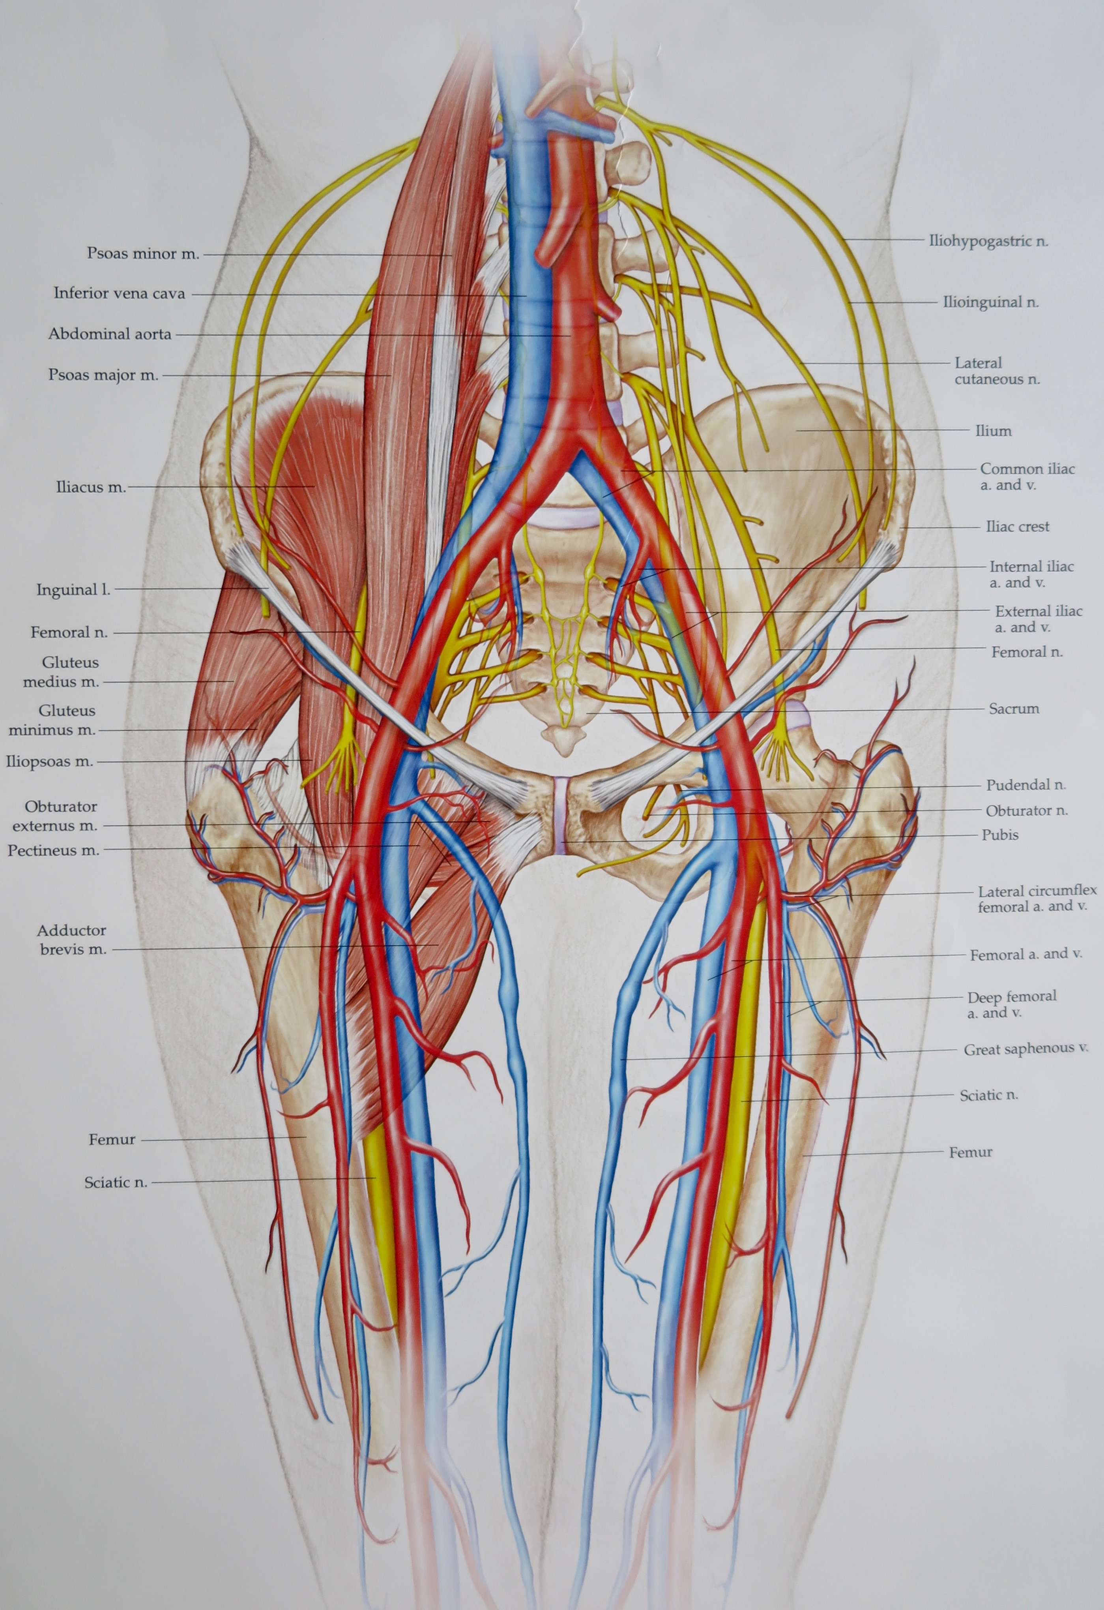
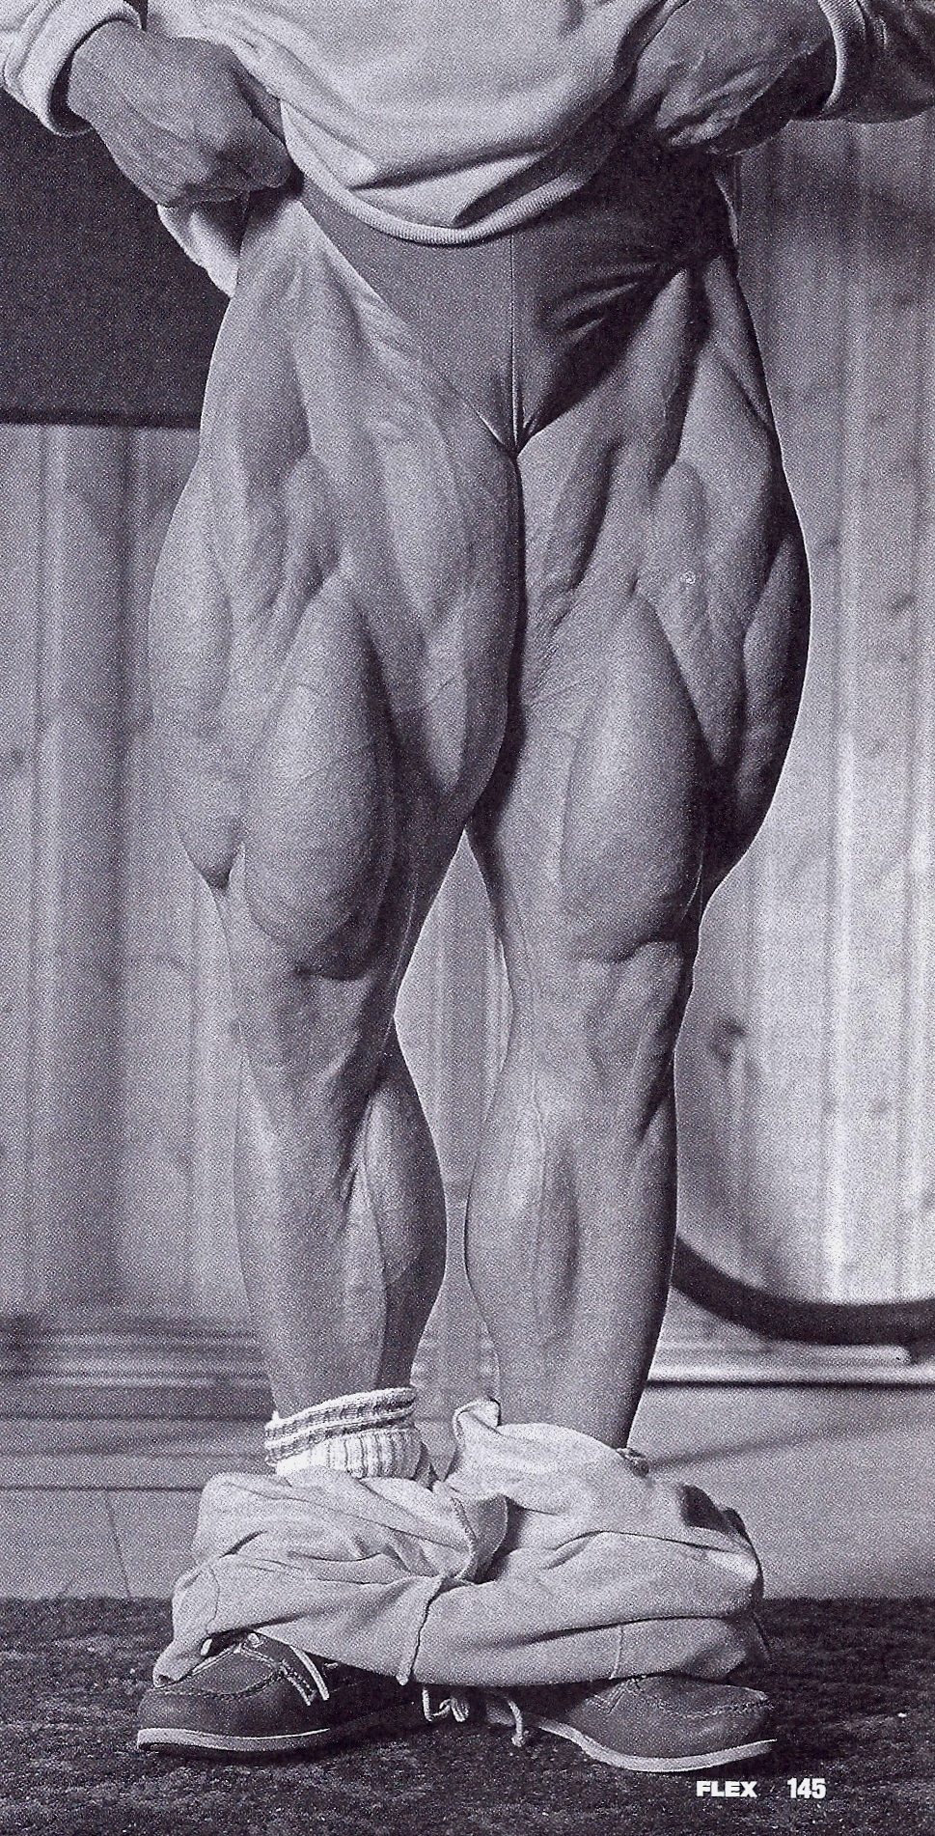
NORMAL ANATOMY:

Slide 7
VISCERAL REFERRAL SITES TO THE SPINE
Herkowitz.H., et al Edt. Rothman-Simeone, The Spine , Vol 1, 5th Edit. 2006. Saunders Elsevier. P.175

Slide 8
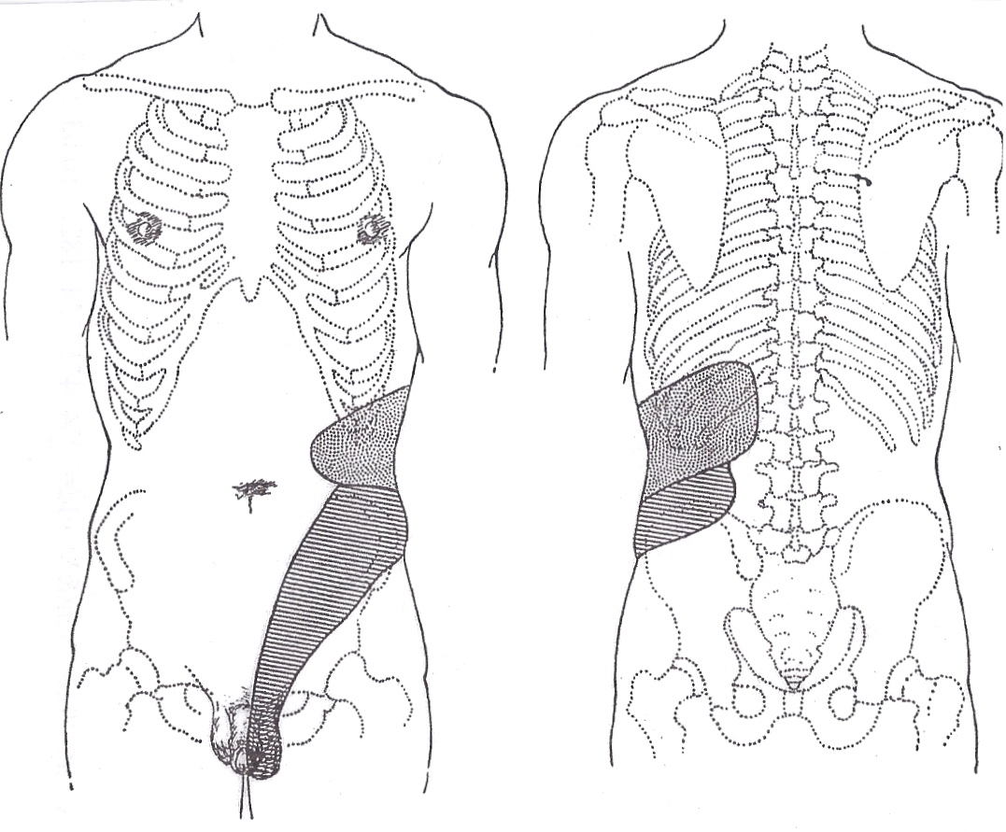
REFERRAL TO THE GROIN FROM AN ORGAN:
Stippled areas indicate kidney referral. Striped areas indicate ureter referral.
Pain is deep and diffuse, poor and unreliable localisation. Poor correlation between amount of visceral pathology and intensity of pain.
Smith. D, General Urology, 8th edition. Lange Medical Publishing, Canada, 1975

Slide 9
THE SPINE: REFERRAL OF PAIN TO THE GROIN FROM THE SPINE
3 IMPORTANT CONCEPTS TO REMEMBER ABOUT THE SPINE!
SIMILAR SPINAL STRUCTURES PROVOKE SIMILAR PAIN PATTERNS IN DIFFERENT PATIENTS!
RADIOLOGISTS AND ORTHOPAEDIC SURGEONS STUDY THEIR IMAGES SEPERATELY!
PATHOLOGIC STRUCTURES ON IMAGING, IN ASYMPTOMATIC PATIENTS!

Slide 10
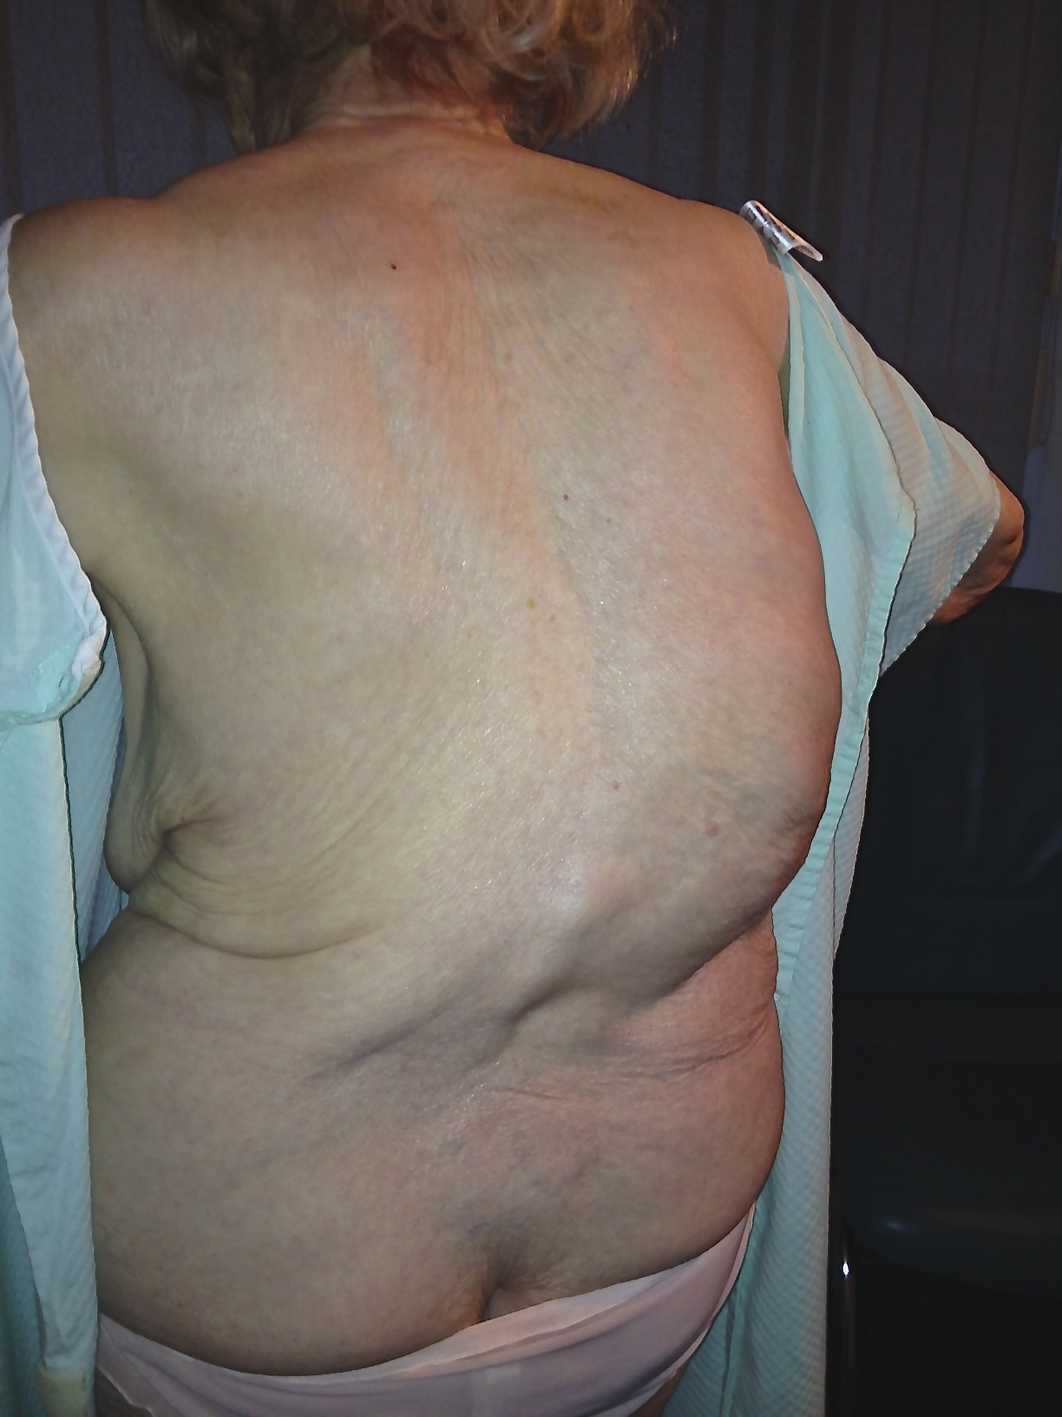
SIMILAR SPINAL STRUCTURES PROVOKE SIMILAR PAIN PATTERNS IN DIFF. PTS.

Slide 11
RADIOLOGISTS AND ORTHOPAEDIC SURGEONS STUDY THEIR IMAGES SEPERATELY
Felson.B. Roentgenology of Fractures and Dislocations. Grune & Stratton, New York. 1978.

Slide 12
DISC ABNORMALITIES IN ASYMPTOMATIC SUBJECTS
Taylor.A,Hughes.T,Resnick.D. Skeletal Imaging. Saunders Elsevier.2nd Edit. 2010. 274

Slide 13
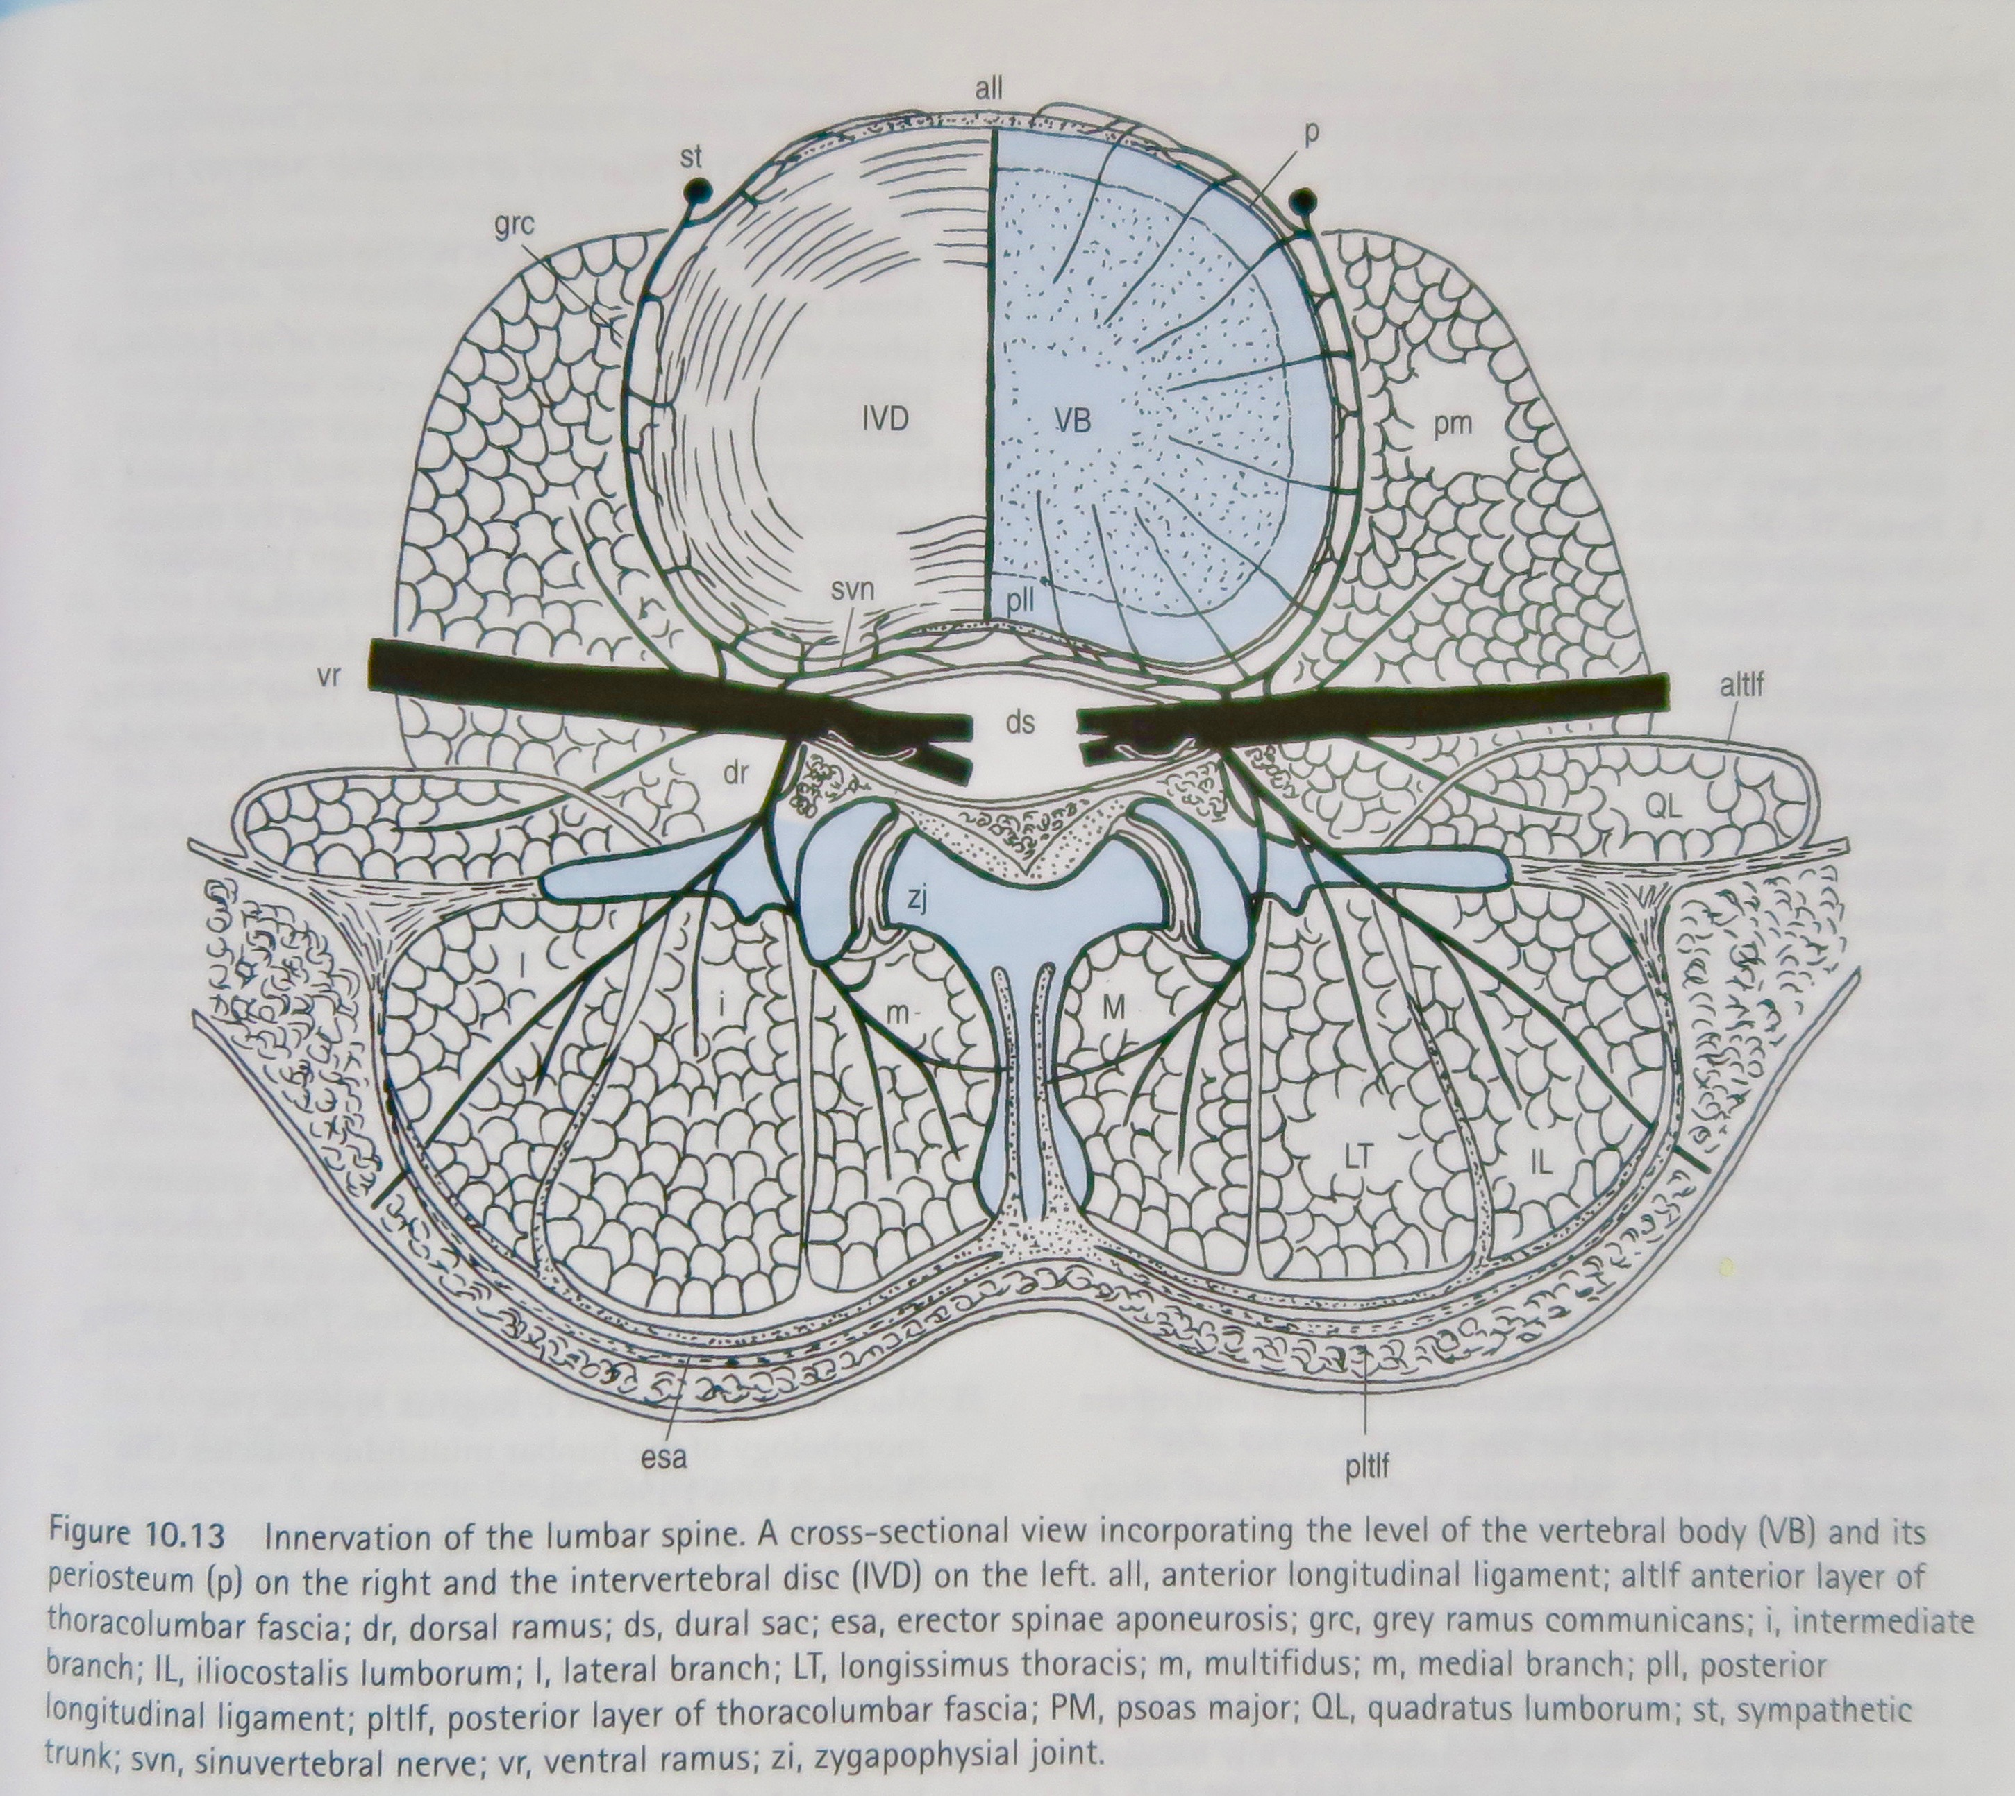
REFERRAL TO THE GROIN FROM SPINAL STRUCTURES
NERVE ROOT PAIN: N.Subcostal/Ilioinguinal/Iliohypogastric/Genitofemoral/Lateral femoral cutaneous nerve
FACET/Zygapophysial joint pain
SACROILIAC JOINT pain
MYOFASCIAL pain (later)
BOGDUK.N. CLINICAL ANATOMY OF THE LUMBAR SPINE AND SACRUM, Elsevier. Churchill, Livingston.4th Edit. 2005.

Slide 14
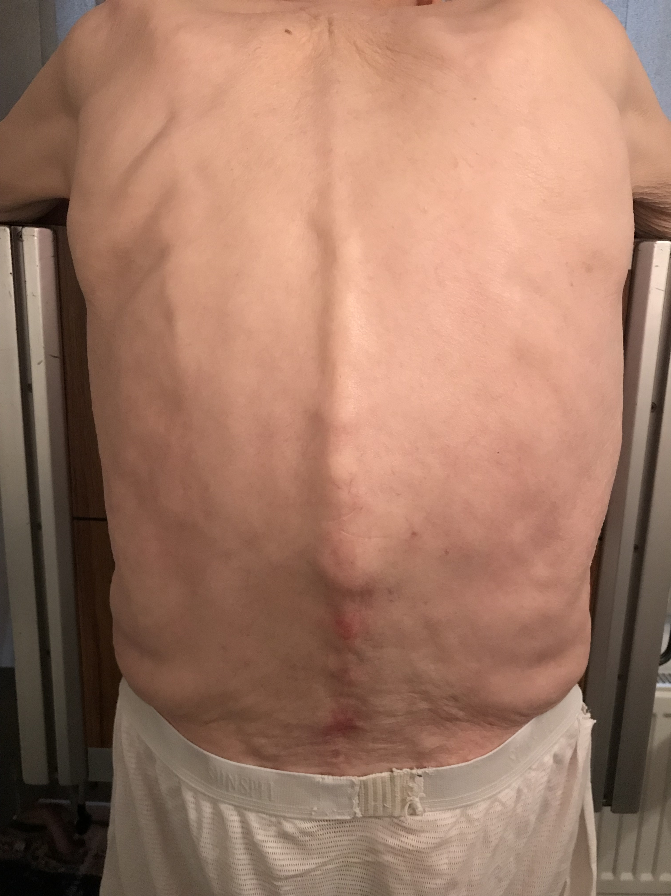
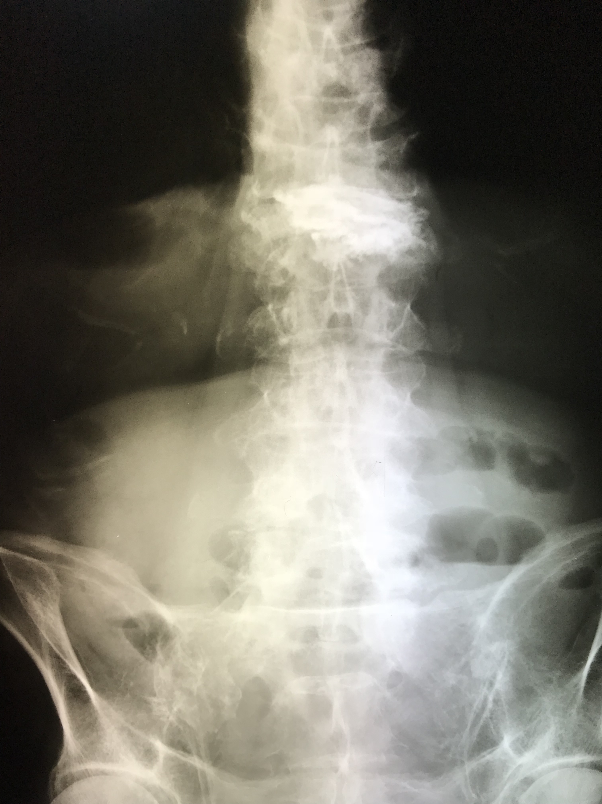
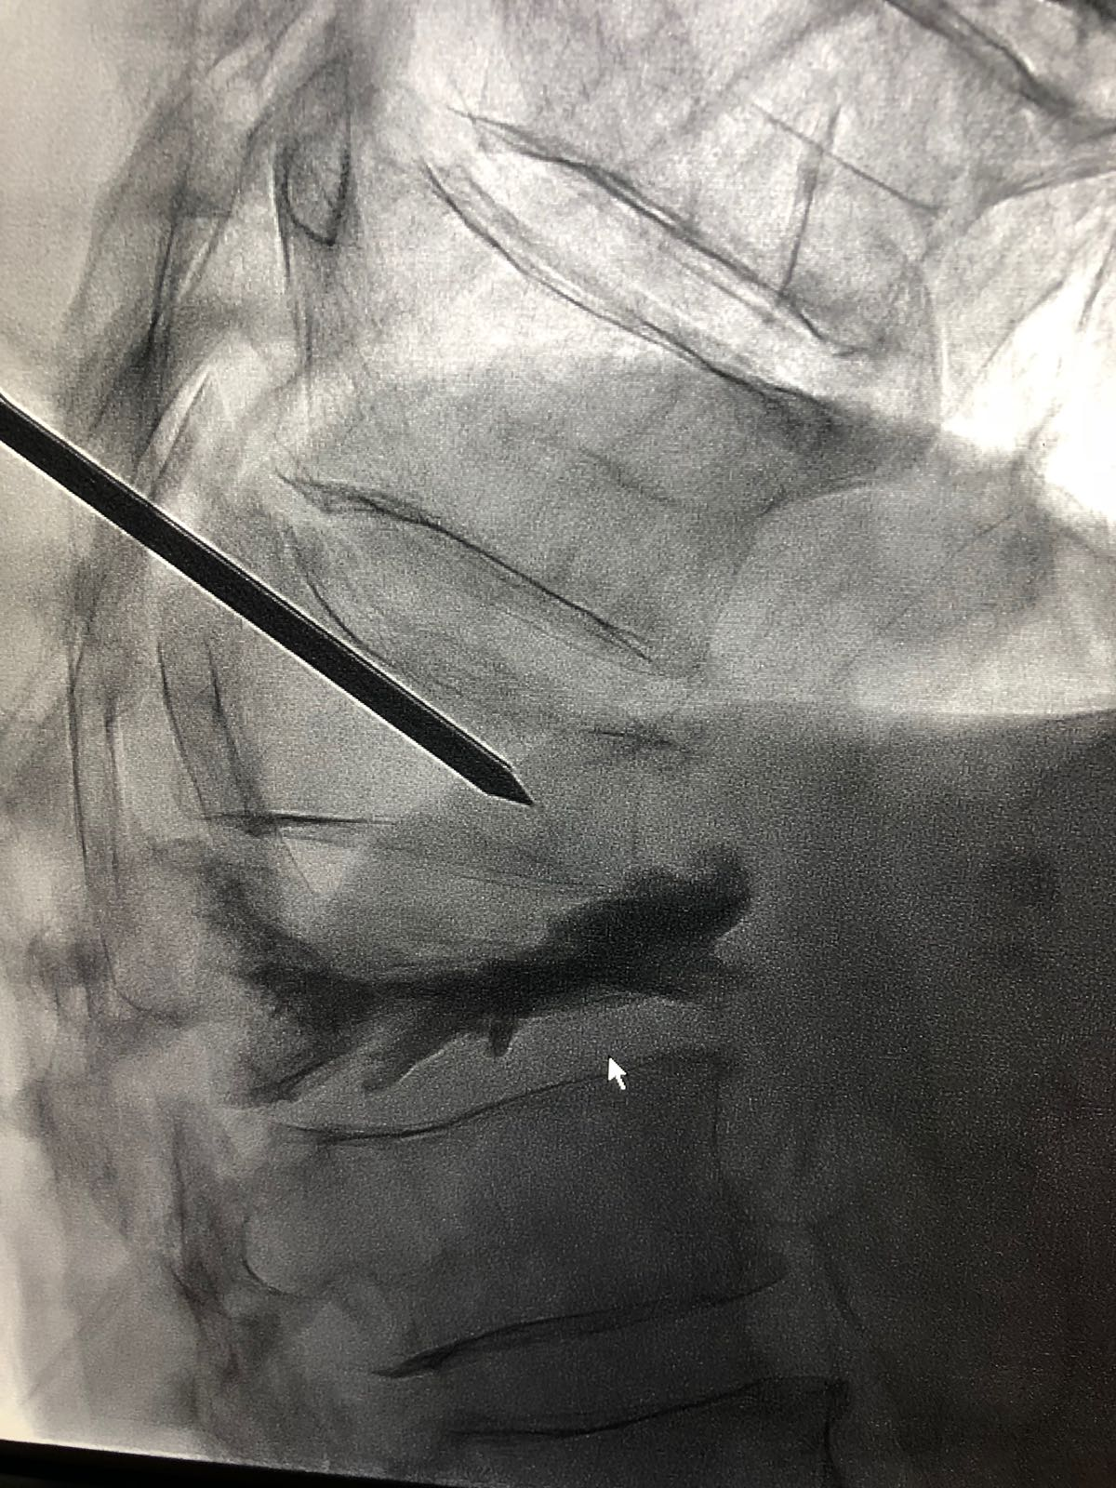
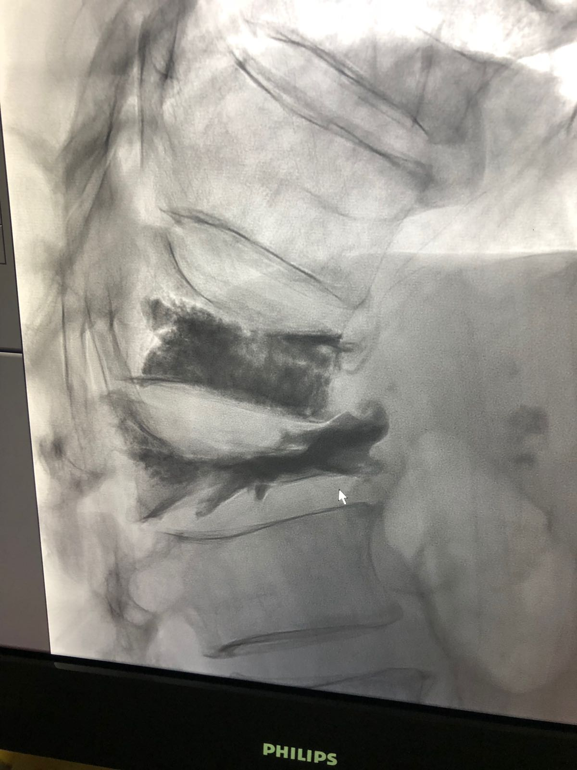
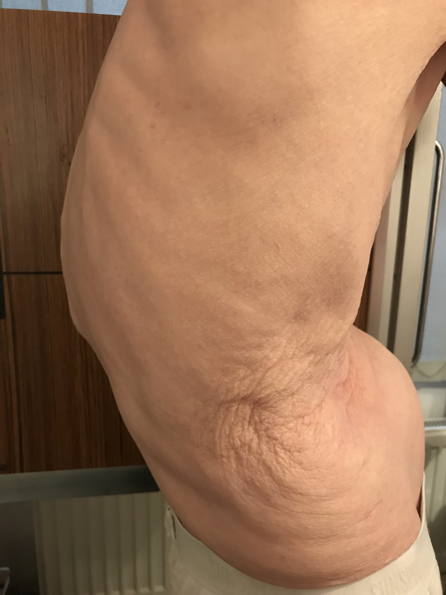
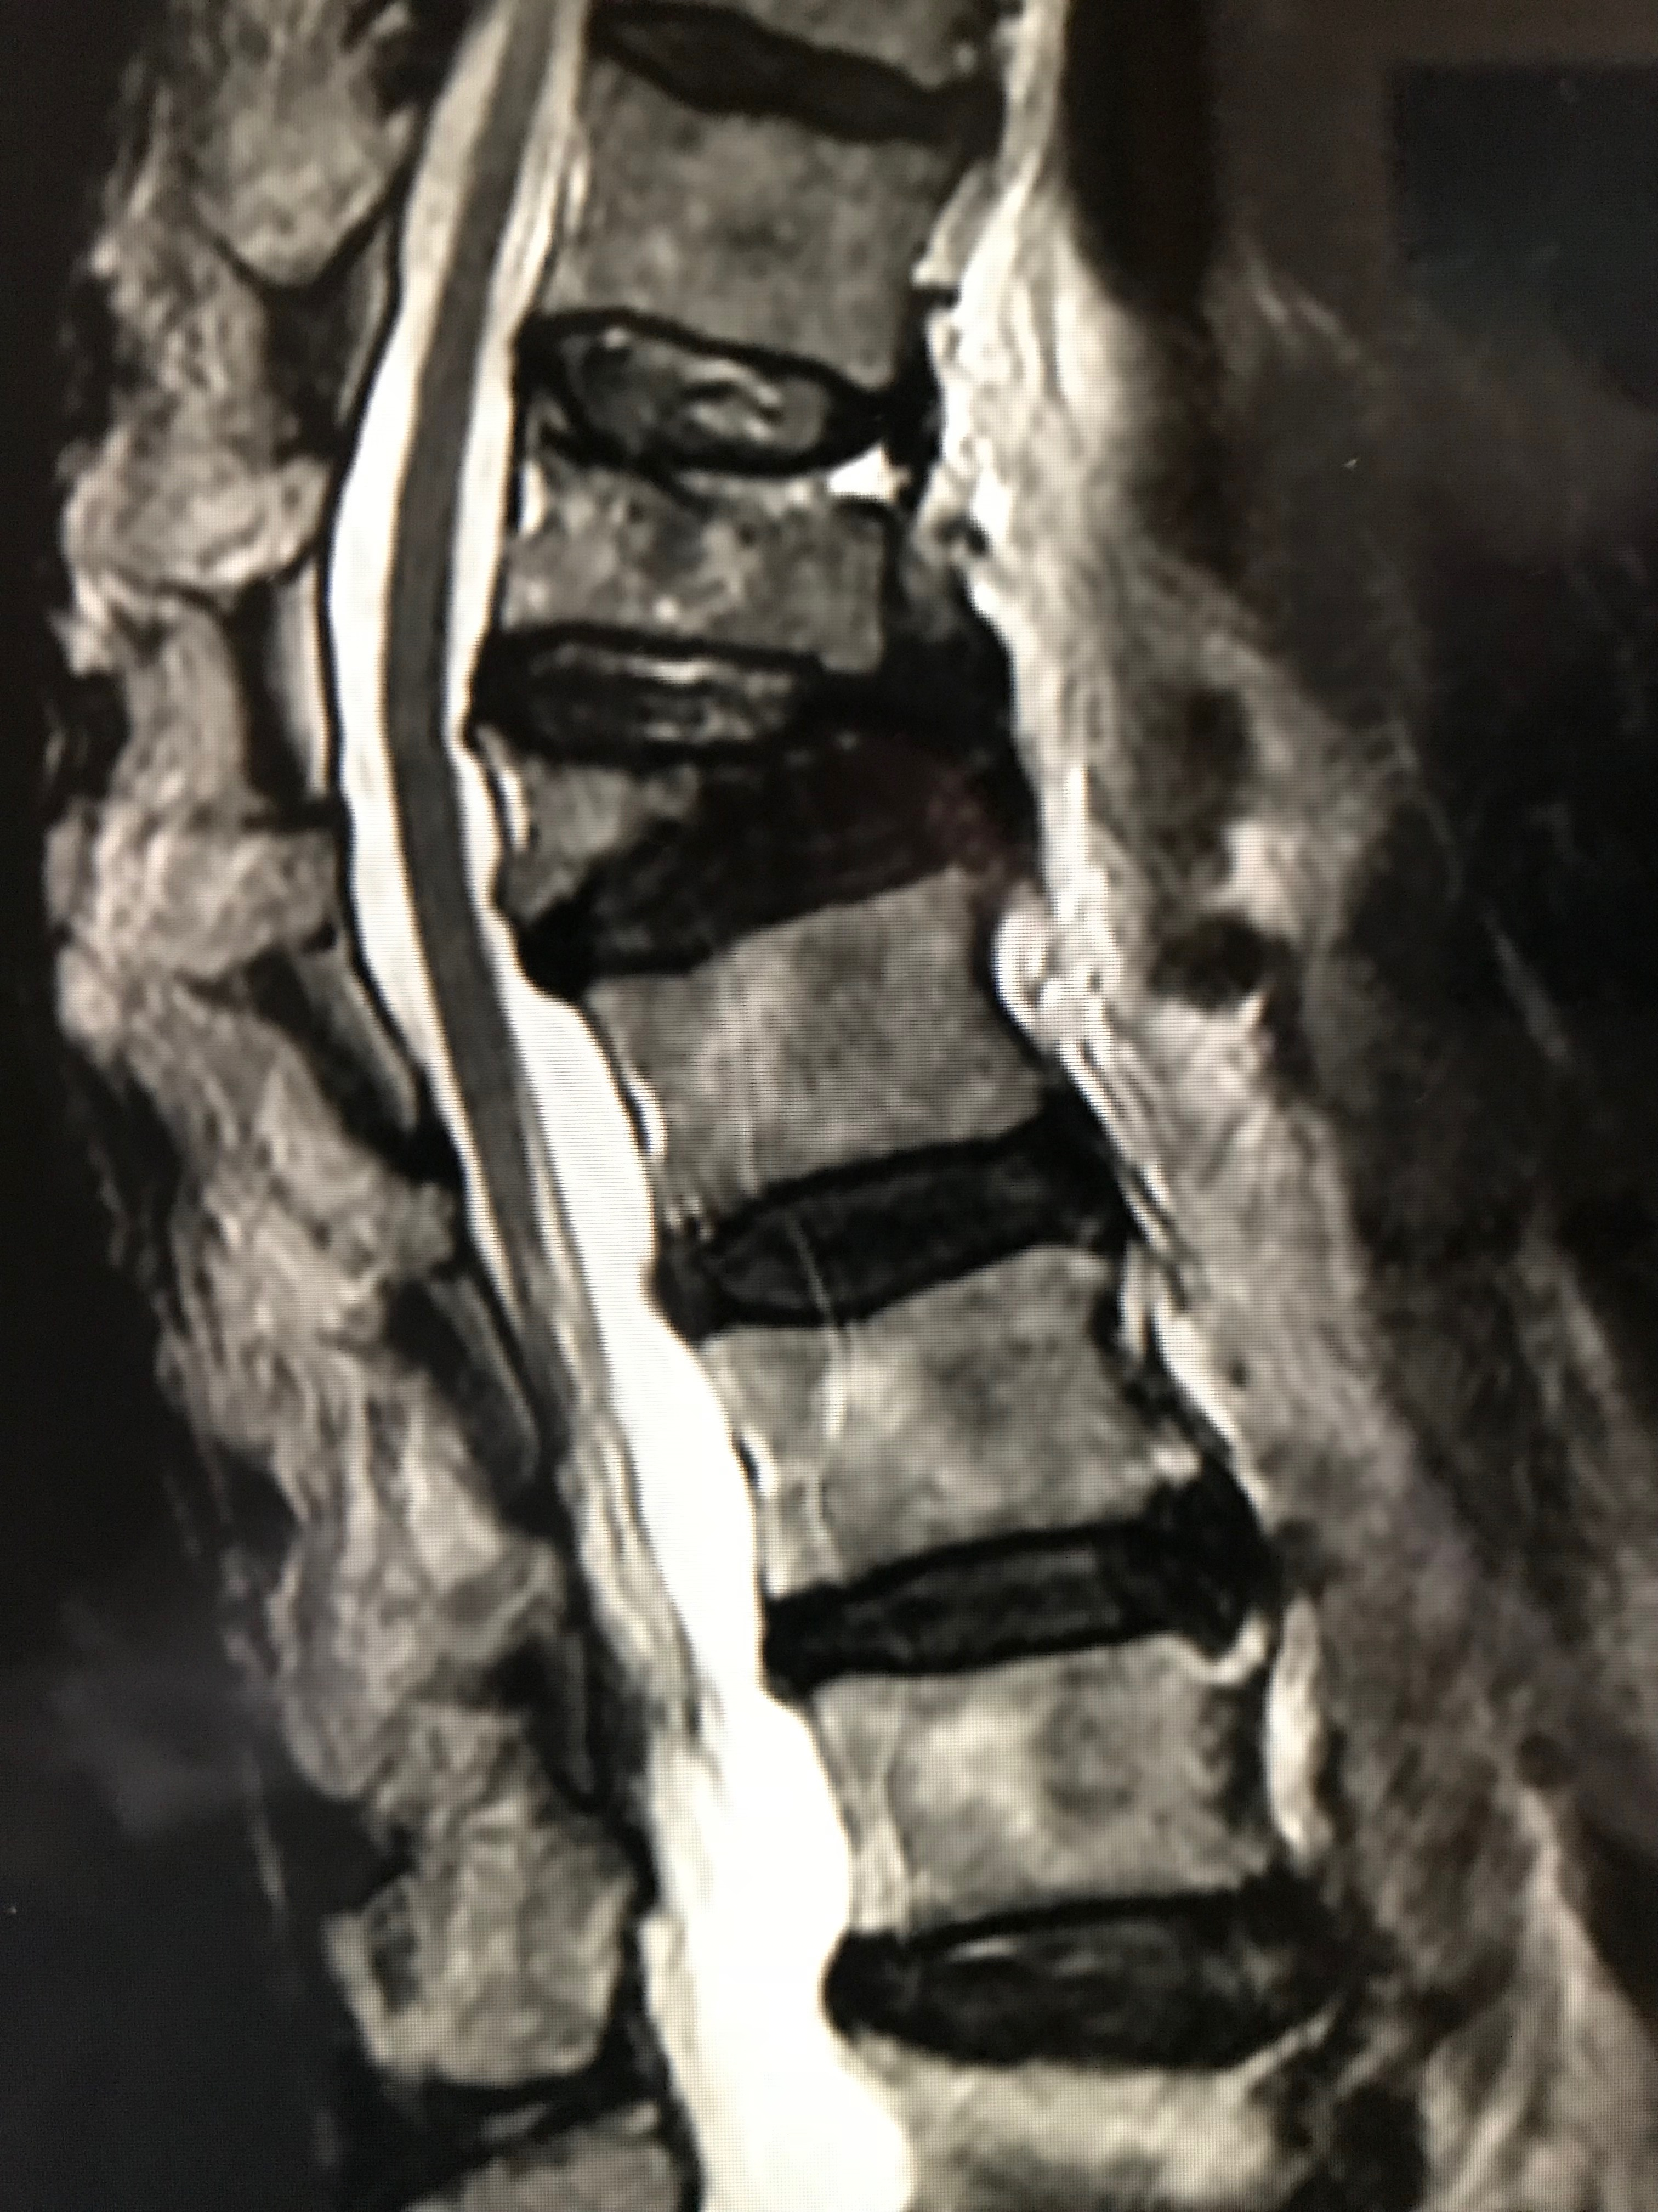
NERVE ROOT PAIN REFERRING TO THE GROIN
T12 Subcostal Nerve(?); L1 Ilioinguinal Nerve; Iliohypogastric Nerve L1-2; Genitofemoral Nerve; L3 Lateral Femoral cutaneous Nerve.

Slide 15
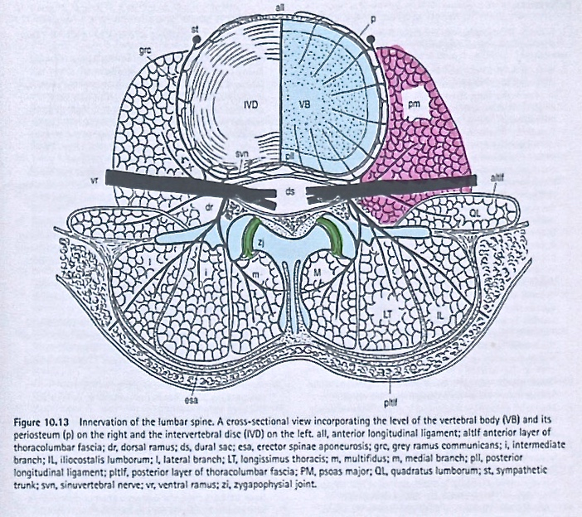
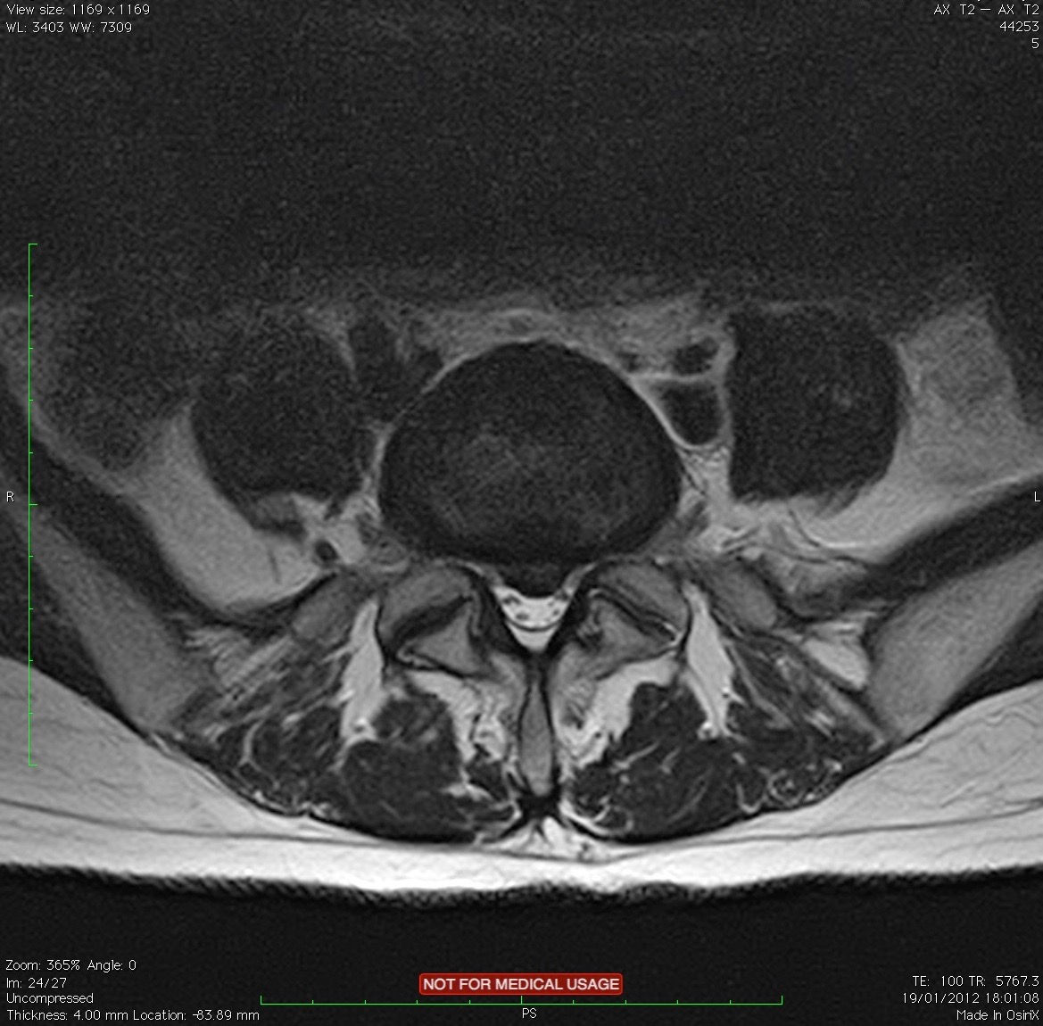
FACET JOINT PAIN REFERRING TO THE GROIN

Slide 16
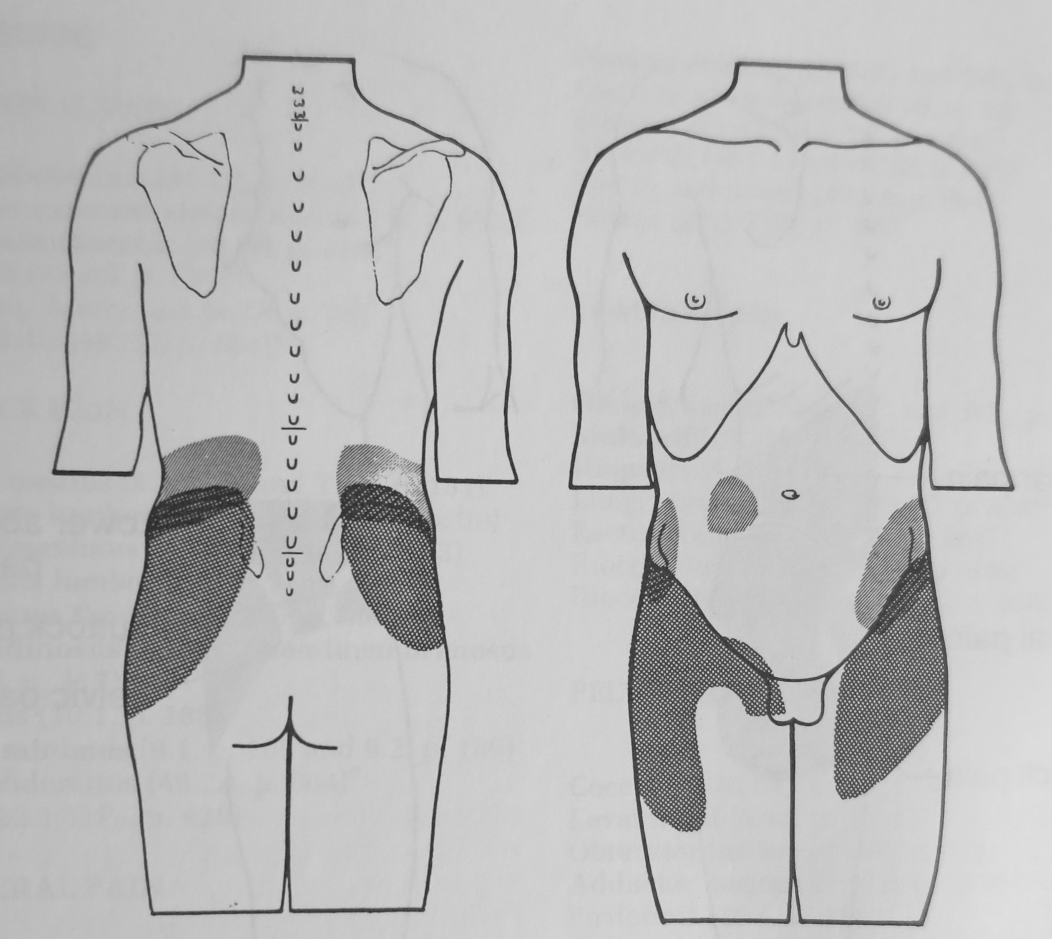
FACET JOINT PAIN REFERRING TO THE GROIN
Composite referred pain patterns induced in six normal subjects by injection of hypertonic saline solution into the zygapophyseal (Facet) joints at L1-2 (diagonal lines, superior pattern), and at L4 – 5 (cross-hatched, inferior pattern).
Despite the difference of three segmental levels between the stimulus injections, the referred pain patterns overlap.
McCall,Park,O’Brien. Induced pain referral from posterior lumbar elements in normal subjects. Spine 4:441-446,1979

Slide 17
SACROILIAC JOINT (SIJ) Controversy: 1
Gray’s Anatomy, records the sacroiliac joint innervation to be, “controversial and not generally agreed and that results of reported studies vary”
Sandring.S.(Edit),Gray’s Anatomy.,39th Edition, Elsevier. 2005.,p.1439.
The SIJ prevalence accounts for 15-25% of low back pain.
Cohen. S.P.Sacroiliac joint pain: a comprehensive review of anatomy, diagnosis, and treatment. Anesth Analg. 2005 Nov;101(5):1440-53.
A recent double blind prospective study showed patients who suffered with SIJ dysfunction causing leg pain response to manipulation of the sacroiliac joint was more effective than intra articular injection.
Visser.L., et.al. Treatment of the sacroiliac joint in patients with leg pain: a randomized-controlled trial. European Spine J. Springer. 2013.Vol.22. No.10. p.2310-2317.

Slide 18
SACROILIAC JOINT (SIJ) Controversy: 2
“The dramatic increase in the diagnosis of sacroiliac joint pain, the use of sacroiliac joint injections and the inevitable subsequent increase in the use of expensive fusion devices to treat sacroiliac joint pain is against a background of no evidence that this will be anything other than a passing phase adhering to the eponymous and repeatedly demonstrated Scott’s parabola”
O’Dowd.J, Hlavsova.A. Spinal Surgery for low back pain: a way forward. European Spine J (2014) 23, April (Suppl 1):S6-S8
Scott.J (2001) Scott’s parabola: the rise and fall of surgical technique. Br Med J 323:1477

Slide 19
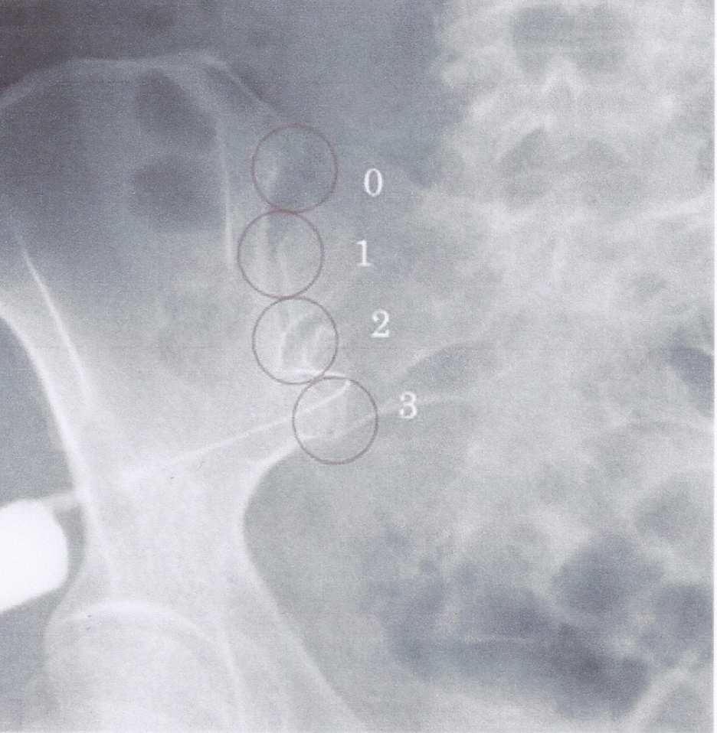
Referred pain location depends on the affected section of the sacroiliac joint
Kurosawa et. al., European Spine Journal. Springer. published online 5th October 2014

Slide 20
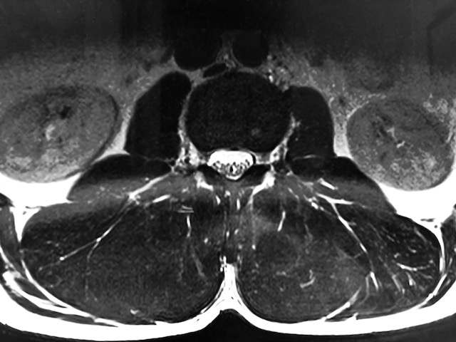
PAIN REFERRAL FROM MUSCLE

Slide 21
WHAT IS MYOFASCIAL PAIN?
MP=PAIN REFERRED FROM MYOFASCIAL TRIGGER POINTS
1. DOES NOT FOLLOW A SIMPLE SEGMENTAL PATTERN.
2.NEITHER DOES IT FOLLOW FAMILIAR NEUROLOGICAL PATTERNS.
3. NEITHER DOES IT FOLLOW THE PAIN PATTERNS FOR REFERRED PAIN OF VISCERAL ORIGIN.
MYOFASCIAL PAIN FREQUENTLY BUT NOT ALWAYS OCCURS WITHIN THE SAME DERMATOME, MYOTOME OR SCLEROTOME AS THAT OF THE TRIGGER POINT, BUT DOES NOT INCLUDE THE ENTIRE SEGMENT-IT OFTEN INCLUDES PARTS OF ADDITIONAL SEGMENTS.

Slide 23
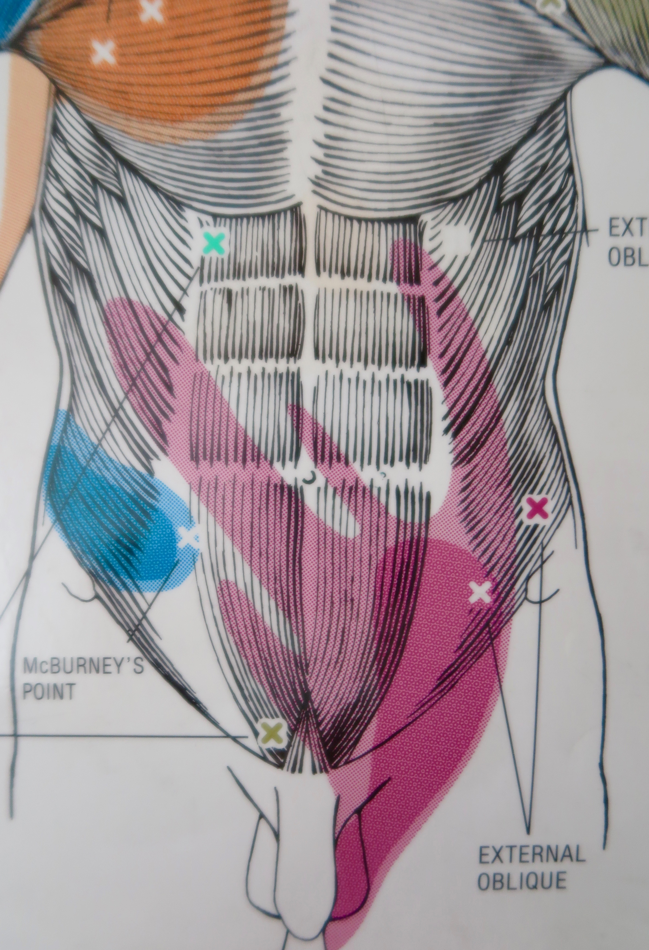
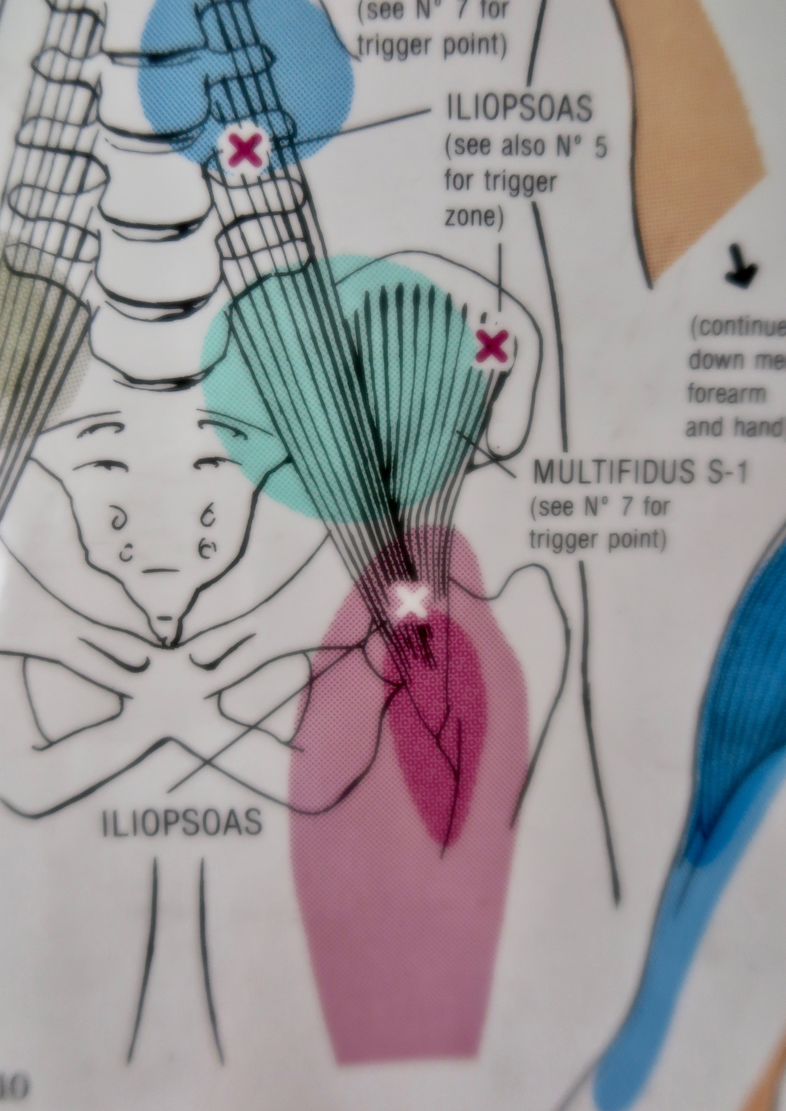
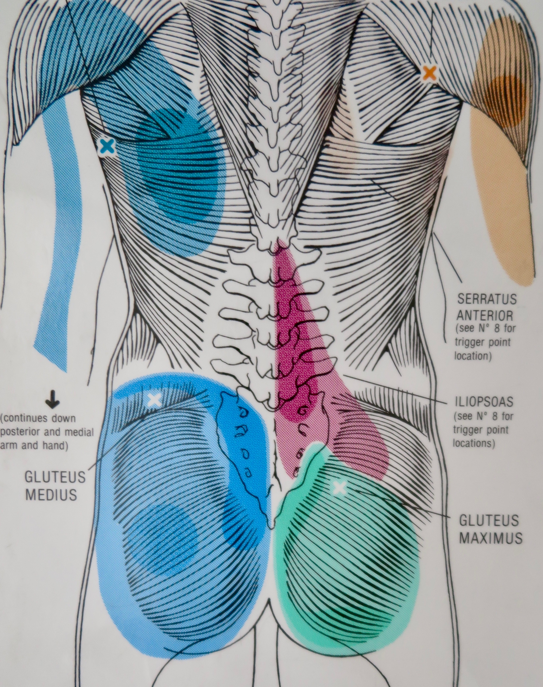
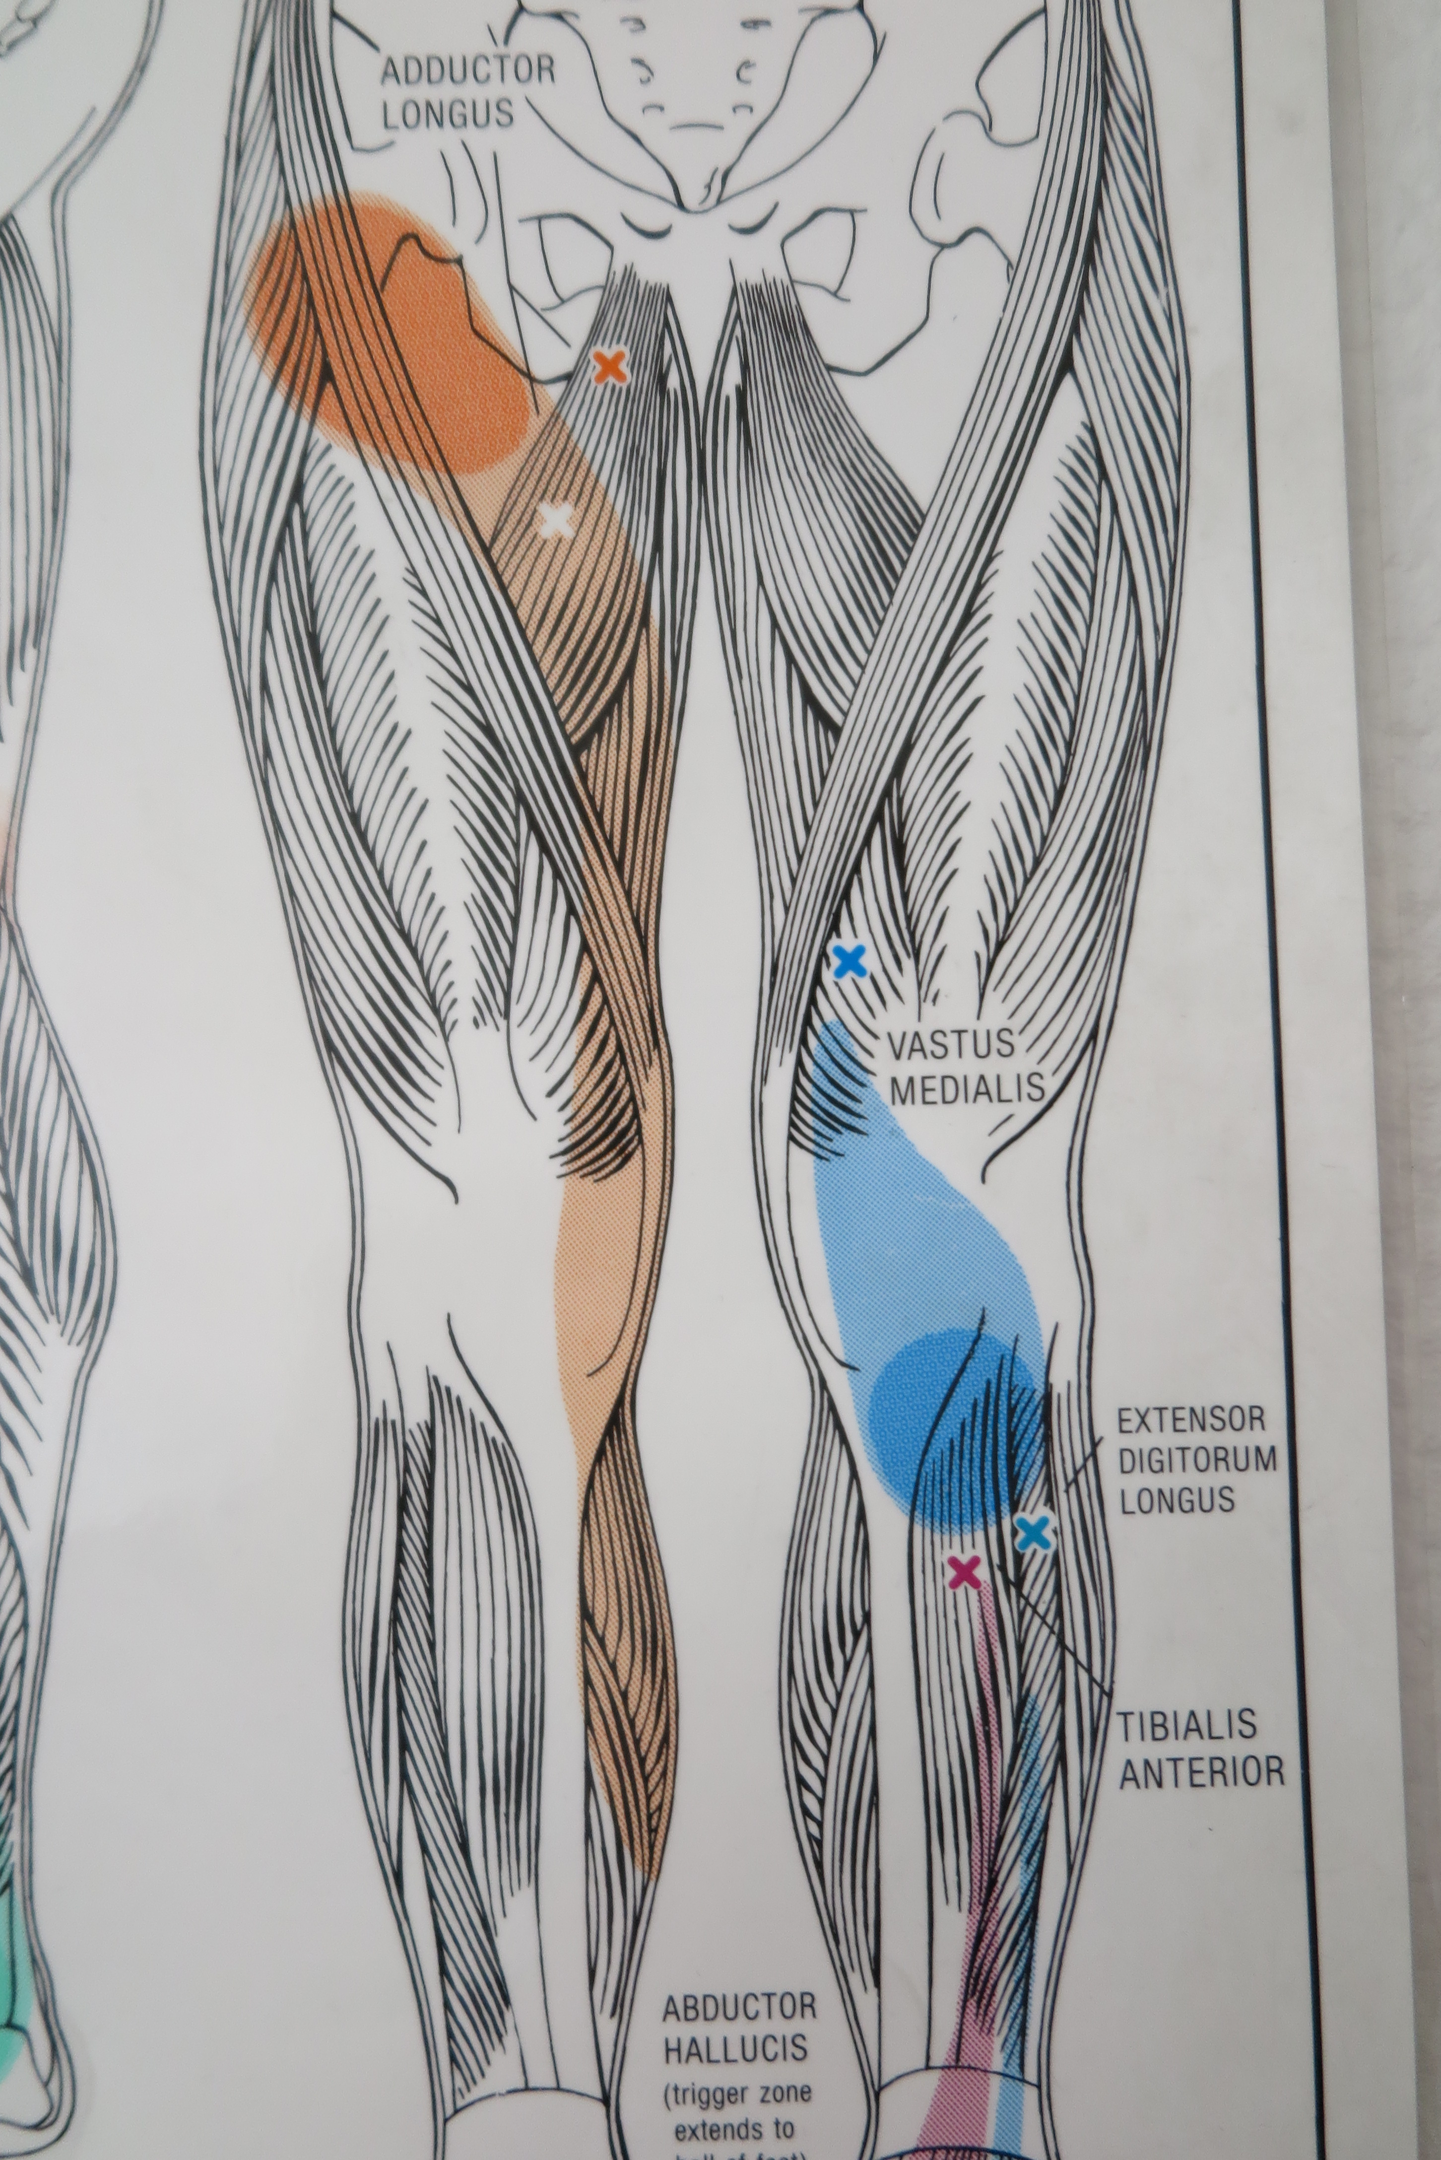
MUSCLE, (MYOFASCIAL TRIGGER POINT), REFERRAL TO THE GROIN
MYOFASCIAL PAIN SYNDROMES:
3 muscles can refer into the groin: Adductor longus, external oblique; Iliopsoas

Slide 24
DIFFERENTIAL DIAGNOSIS

Slide 25
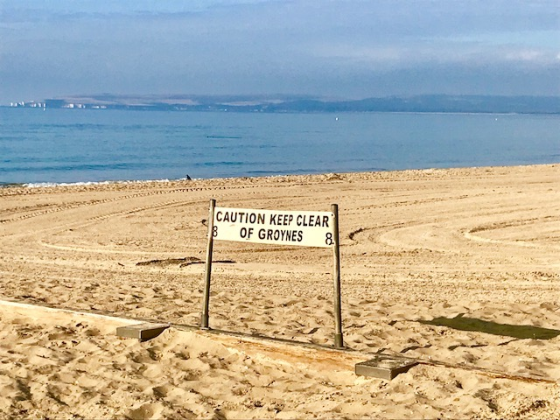
THANK YOU

